Slide 1
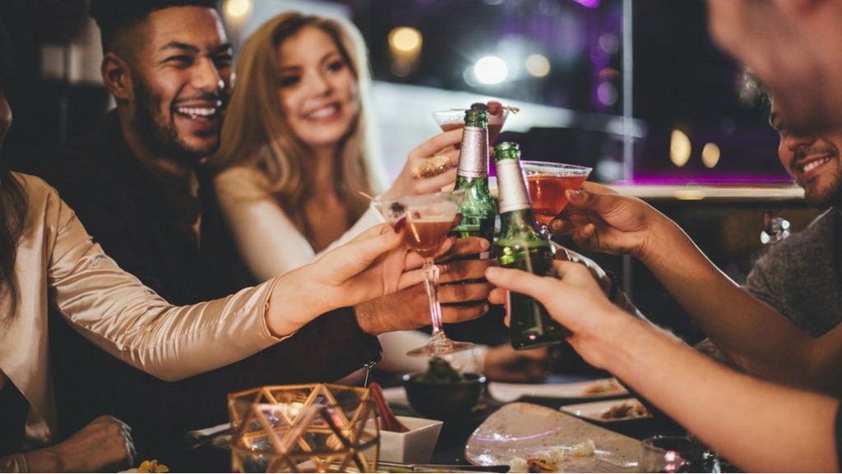
Effect on academic performance of secondary students consuming alcohol
Prepared By: Priya Payyadi Surendran
ID: 1533656

Slide 2
Agenda
Problem Statement
K means Clustering
Filtered Clustering
Naïve Bayesian
K Nearest Neighbour
Difficulties and Solution
Analysis of Findings & Best Technique
Conclusion
Future Improvement

Slide 3
Problem Statement
Any relationship between alcohol consumption and student’s academic performance
Explored on research in UK regarding alcohol consumption and academic performance
I wanted to explore if alcohol consumption can be used to predict a students academic result.
Are there any other factors that can impact this prediction!!

Slide 4
Techniques used
Unsupervised Technique
K Means Clustering
Filtered Clustering
Classification
Naïve Bayesian
K Nearest Neighbour

Slide 5
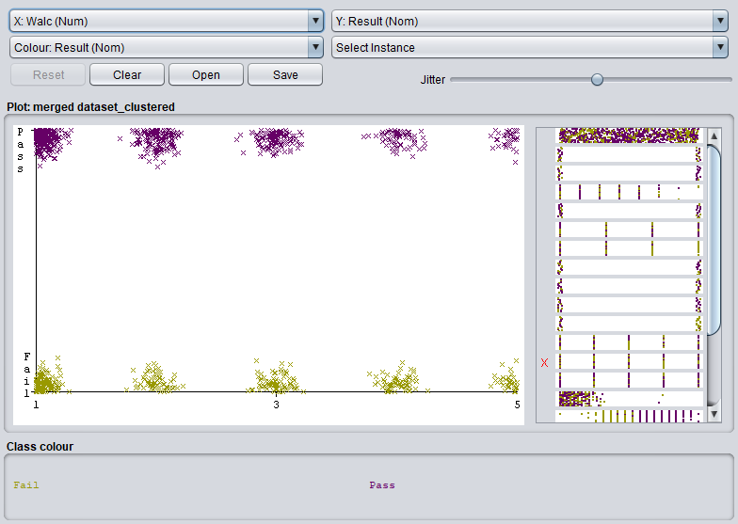
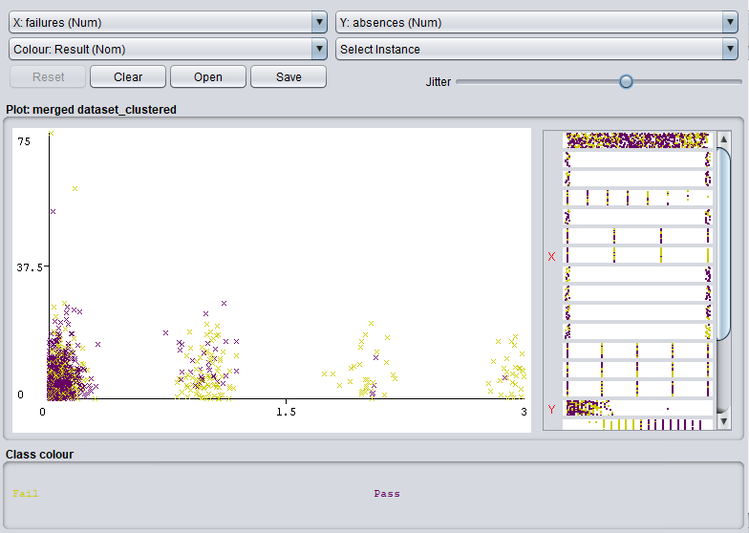
K Means Clustering
K Means Clustering demonstrates no evidence of correlation between academic performance and alcohol consumption.
However you can see a strong cluster here for success among students with fewer absences and fewer previous failures.

Slide 6
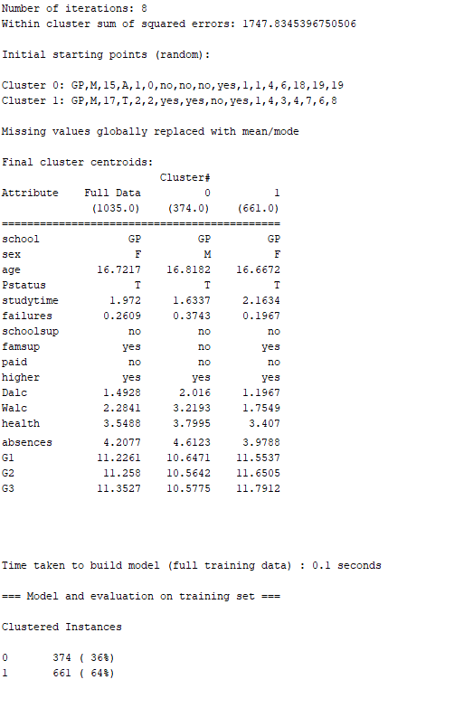
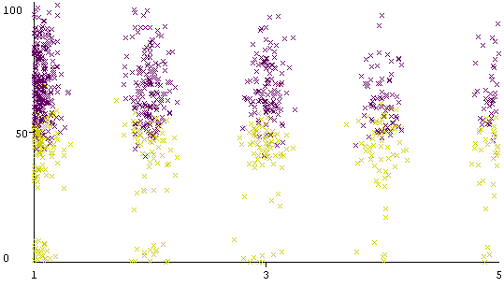
Filtered Clustering
Filtered clustering is similar to K Means Clustering. For this I used the plain allfilter. The SSE is 1747 which was lesser than the K Means Clustering.
There was again no notable correlation between academic performance and alcohol consumption.

Slide 7
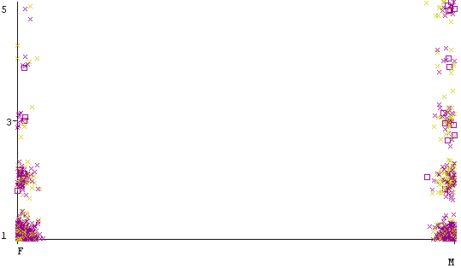
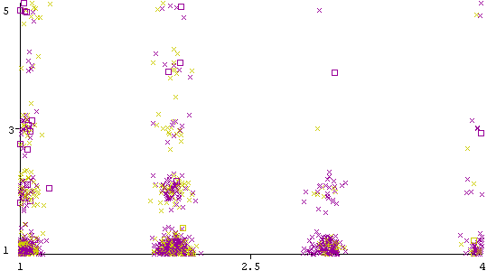
Naïve Bayesian
The performance of Naïve Bayes was better than ZeroR. The accuracy of Naïve Bayes was 96% compared to 64% of ZeroR.

Slide 8
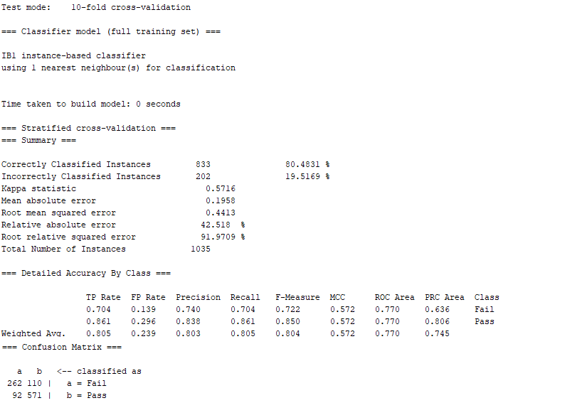
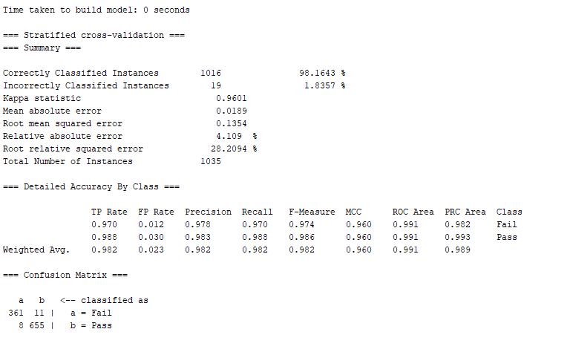
K Nearest Neighbour
cross validation of 10 folds were used as test option to execute k nearest neighbour and the accuracy obtained was 80%.
When major attributes were ignored and only the gender, daily and weekly alcohol consumptions were measured against the Result attribute, the accuracy increased to 98% .
From the summary of KNN, it is obvious that student’s performance is not solely dependent on the alcohol consumption. Other factors also effects the academic performance.

Slide 9
Difficulties & Solutions
The major problem I identified is the less or weak correlation between the alcohol consumption and the academic performance of the student.
Hence, I’m not sure if I have applied the correct techniques or not.
I found it difficult to infer something from the dataset based on the daily and weekly alcohol consumption.
I strongly feel that many other factors like family, lifestyle etc also effects the academic performance of the student.

Slide 10
Analysis of findings and best technique
I found that the Naïve Bayes Classification proved to be superlative at classifying and predicting the academic performance especially the success rate of students and the accuracy was almost 96%.
In unison, K Nearest Neighbour Classification gave an 80% accuracy. Hence these algorithms can be organized to create a very accurate model with further tuning.
From the data mining techniques used, I learned that the correlation between student’s academic performance and alcohol consumption is less.
Technique Used | Correctly Classified Instances | SSE/Cross Validation | Accuracy (%)
K Means Clustering | 663 | 2170.32 | 64%
Filtered Clustering | 661 | 1747.83 | 64%
Naïve Bayesian Classification | 989 | 10-fold cross validation | 95.56%
K Nearest Neighbor | 833 | 10-fold cross validation | 80.48%

Slide 11
Conclusion
Correlation between academic performance and alcohol consumption was weak. I couldn’t infer much from regarding the relationship.
Boys consumed more alcohol daily compared to girls whereas during weekends girls consumed as much as boys.
But girl’s success rate was more compared to boys proving that girl’s study more than boys and have high tolerance towards alcohol’s effect.
It was also observed that, student whose parents are still living together consumed more alcohol compared to the students whose parents were apart.
Also, more students who consumed alcohol daily and weekly have more failures.

Slide 12
Future Improvement
Must use larger and messier dataset with more instances and data from different schools from different locations.
Although couldn’t infer much from the dataset, may be higher alcohol consumption rate do impact the academic performance of the student.
Other factors like family background, lifestyle, parents, interests, diversions etc impacts student performance too.

Slide 13
Thank You!

